Slide 1

1.5 Data Extraction & Processing Part - III
© London Academy of IT, www.londonacademyofit.co.uk

Slide 2
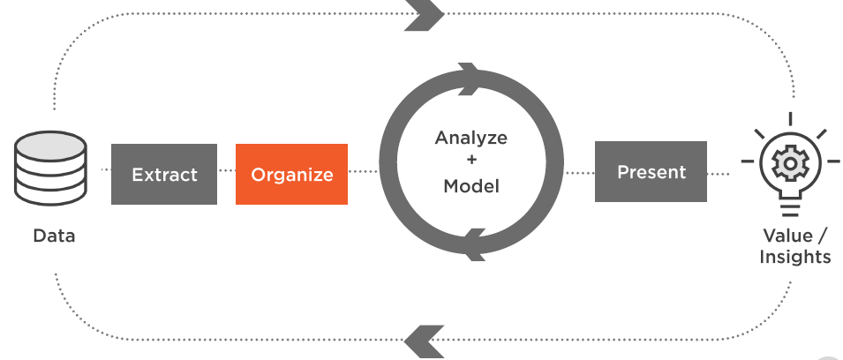
Data Science Project Life Cycle

Slide 3
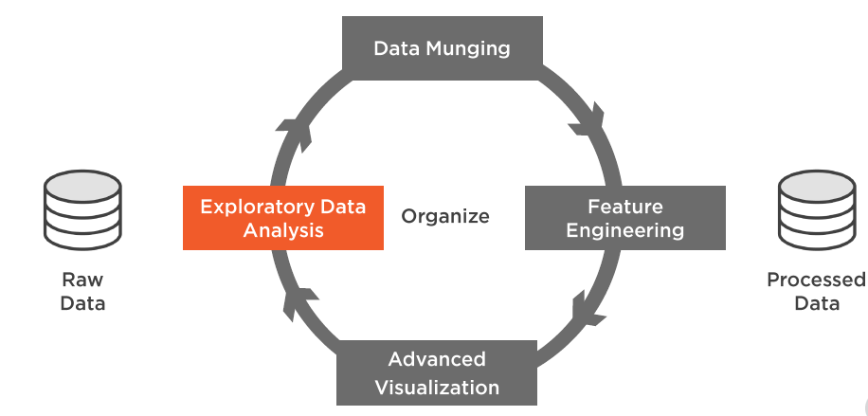
Data Science Project Life Cycle

Slide 4
Session Overview
Data Munging
Feature Engineering
Visualization

Slide 5
Data Munging
Treating Missing Values
Treating Outliers

Slide 6
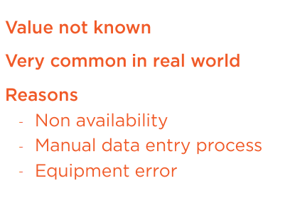
Missing Values

Slide 7
Missing Values

Slide 8
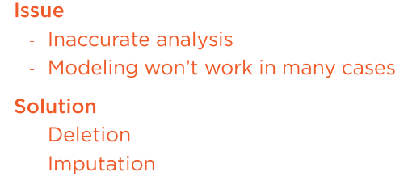
Missing Values

Slide 9
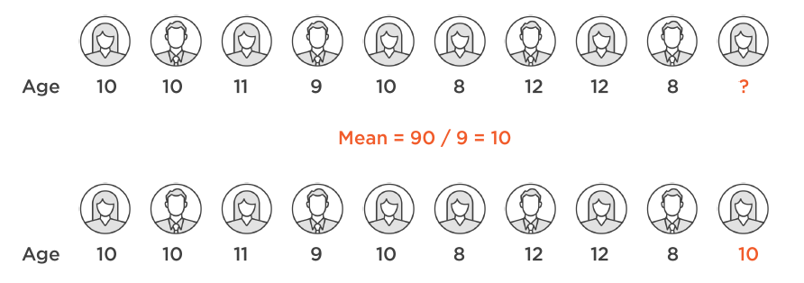
Mean - Imputation

Slide 10
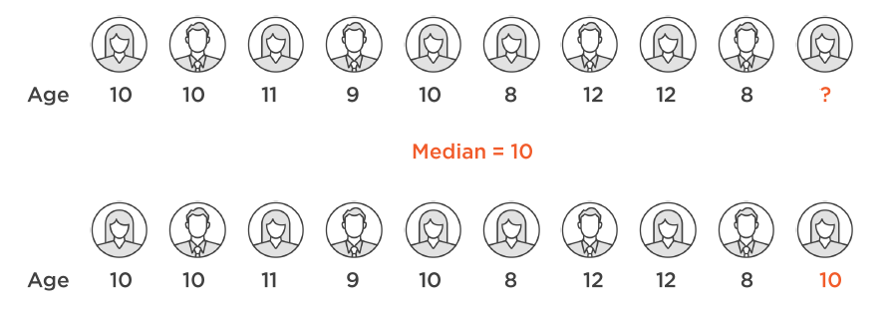
Median - Imputation

Slide 11
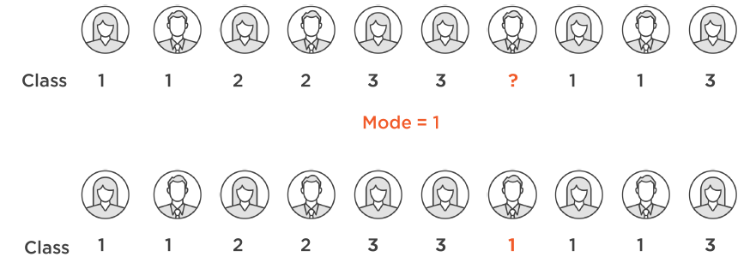
Mode - Imputation

Slide 12

Treating Missing Values - Demo
Treating Missing values using Python NumPy and Pandas

Slide 13
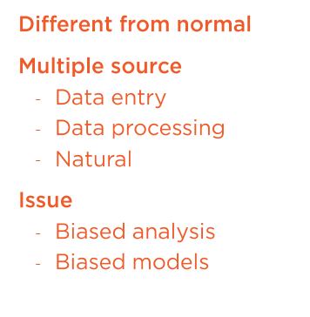
Outliers

Slide 14
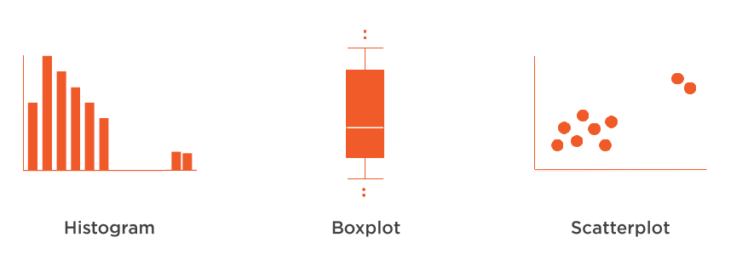
Outliers Detection

Slide 15
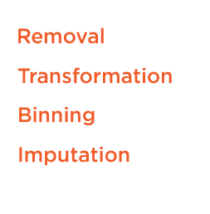
Outliers Treatment

Slide 16
Outliers Treatment - Demo
Outliers Treatment using Python NumPy and Pandas

Slide 17

Feature Engineering

Slide 18
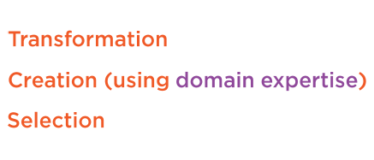
Feature Engineering

Slide 19
Feature Engineering - Demo
Feature Engineering using Python NumPy and Pandas

Slide 20

Categorical Feature Encoding
Binary Encoding
Label Encoding
One-Hot Encoding

Slide 21
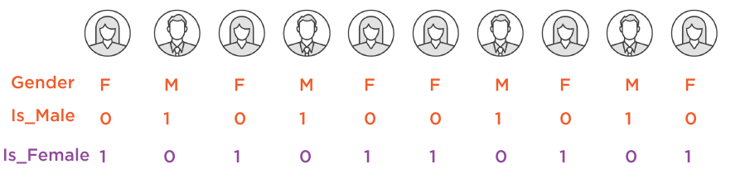
Binary Encoding

Slide 22
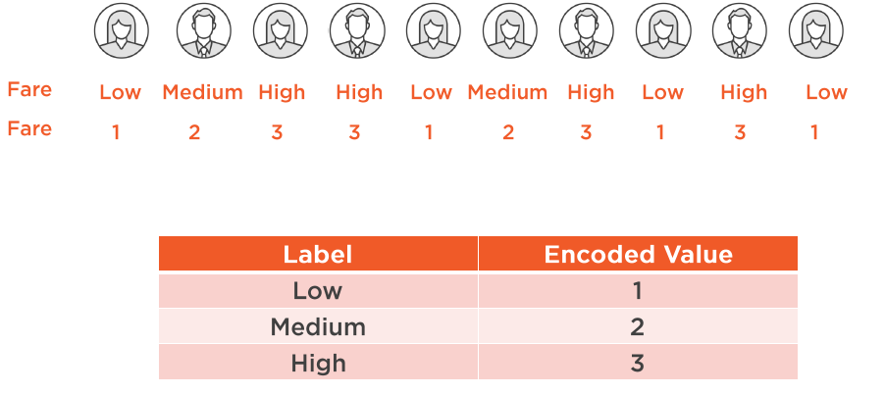
Label Encoding

Slide 23
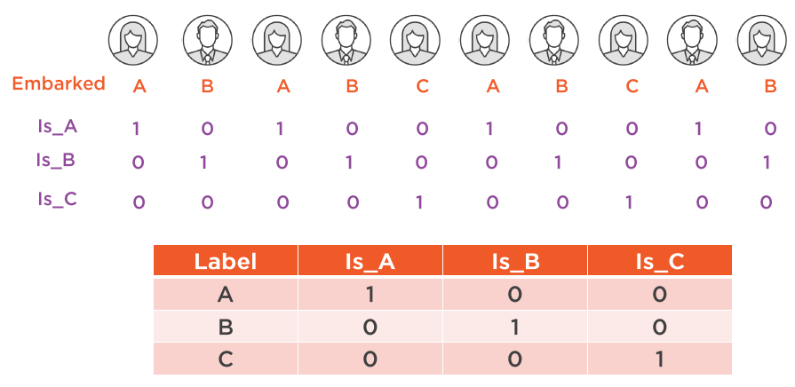
One-Hot Encoding

Slide 24
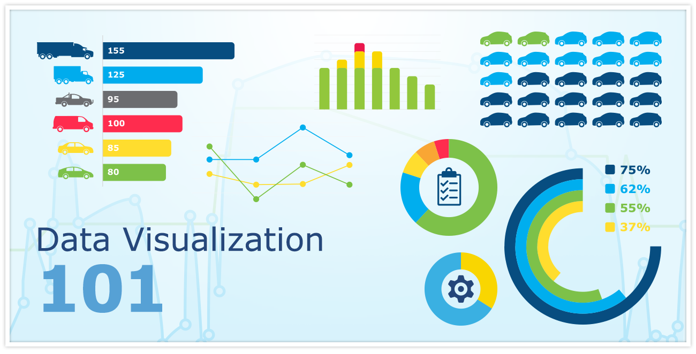
Visualization

Slide 25
Visualization - Demo
Visualization using Python NumPy and Pandas

